Slide 1
COFFEE SITE Presented by Mrigakshy kalita

Slide 2
agenda
Introduction
Working
Uses
Advantages & Disadvantages
Future scopes

Slide 3
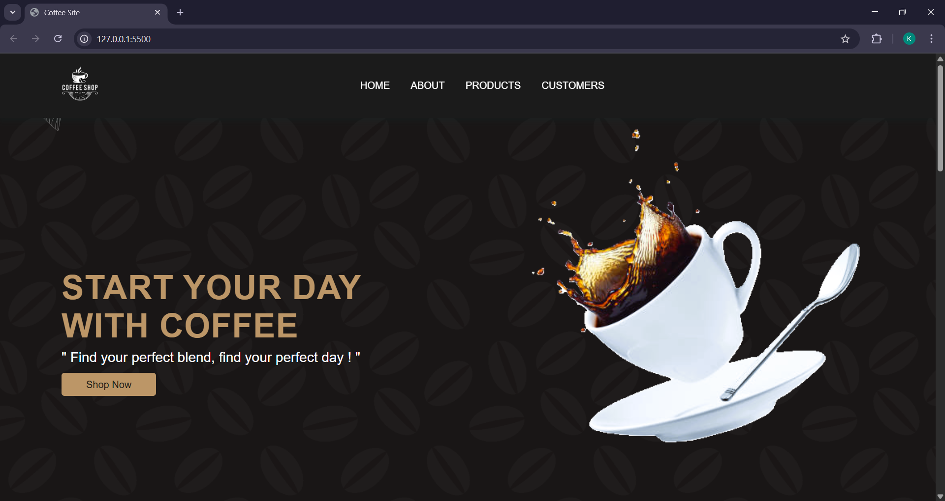
Introduction
"Welcome to our Coffee Website project! This project aims to create an online platform for coffee enthusiasts to explore and purchase various coffee products.“
Brief overview: "Our website provides a user-friendly interface for customers to browse and buy coffee products, read reviews, and learn about the coffee shop."

Slide 4
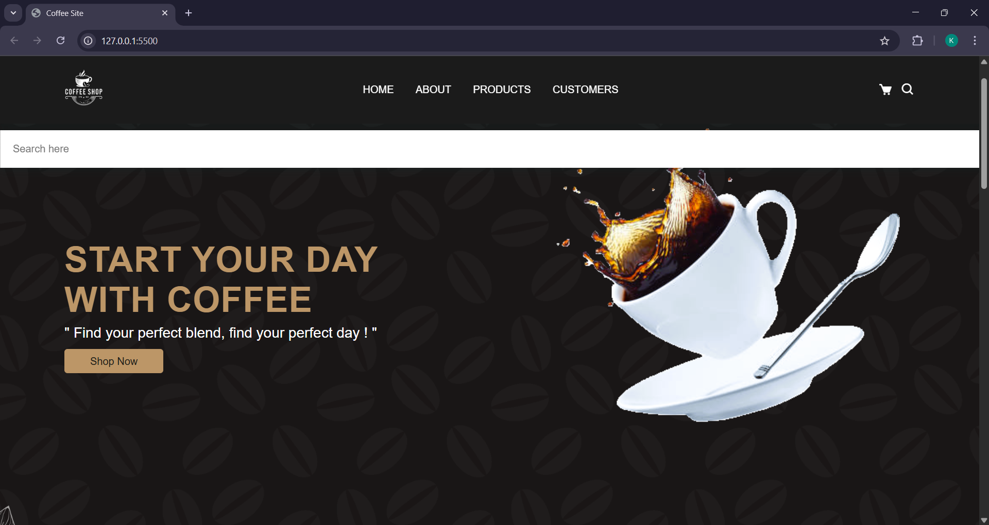
working
Our website works as follows:
- Users can browse products, read reviews, but making purchases is still in progress.
- The website is designed with a responsive layout for easy navigation on various devices.
The website is built using HTML, CSS, and a little bit of JavaScript (in the appearance & hiding of the search bar).
Explanation: "Our website is designed to provide a seamless user experience, allowing customers to easily find their favourite coffee products."

Slide 5
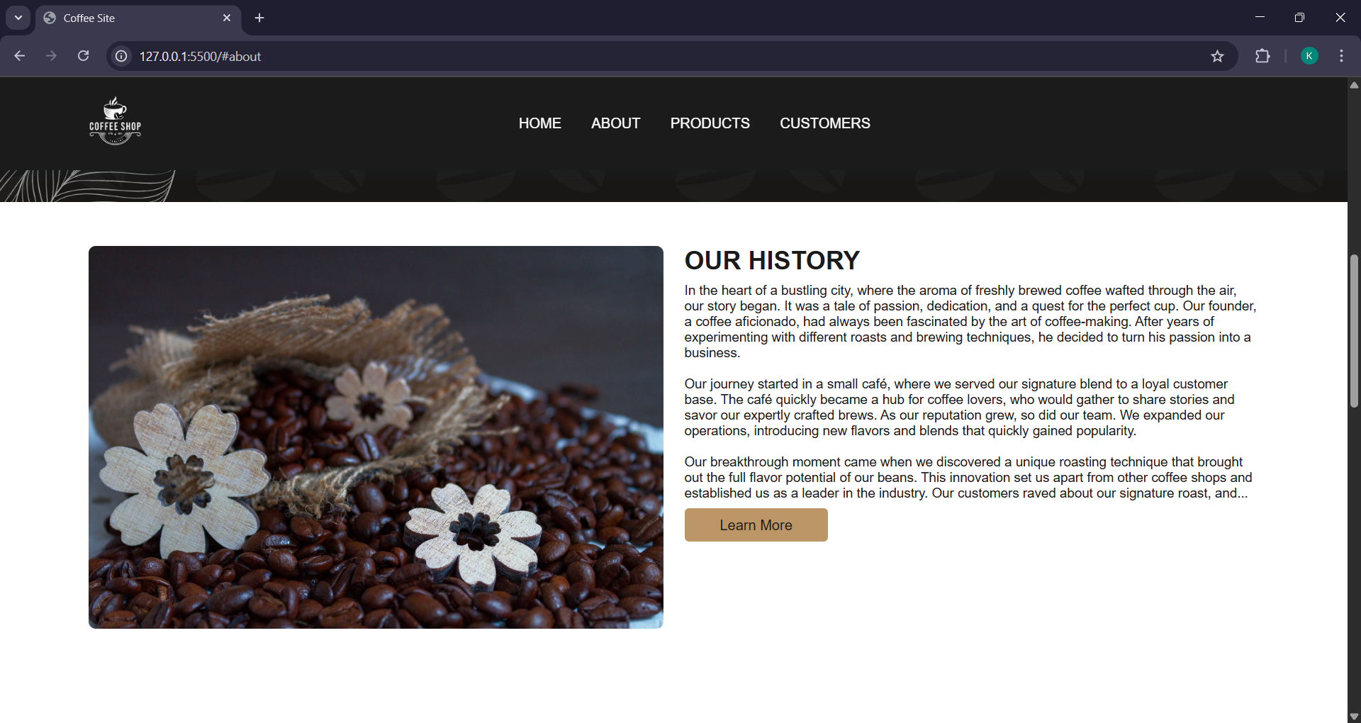
ABOUT SECTION

Slide 6
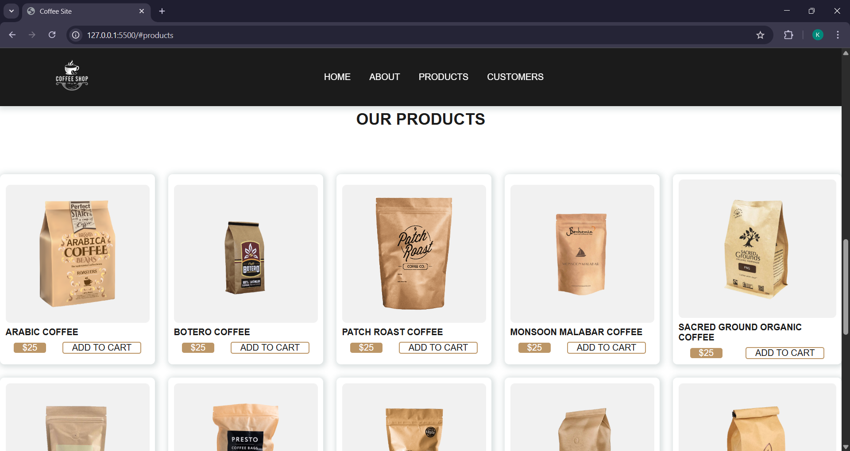
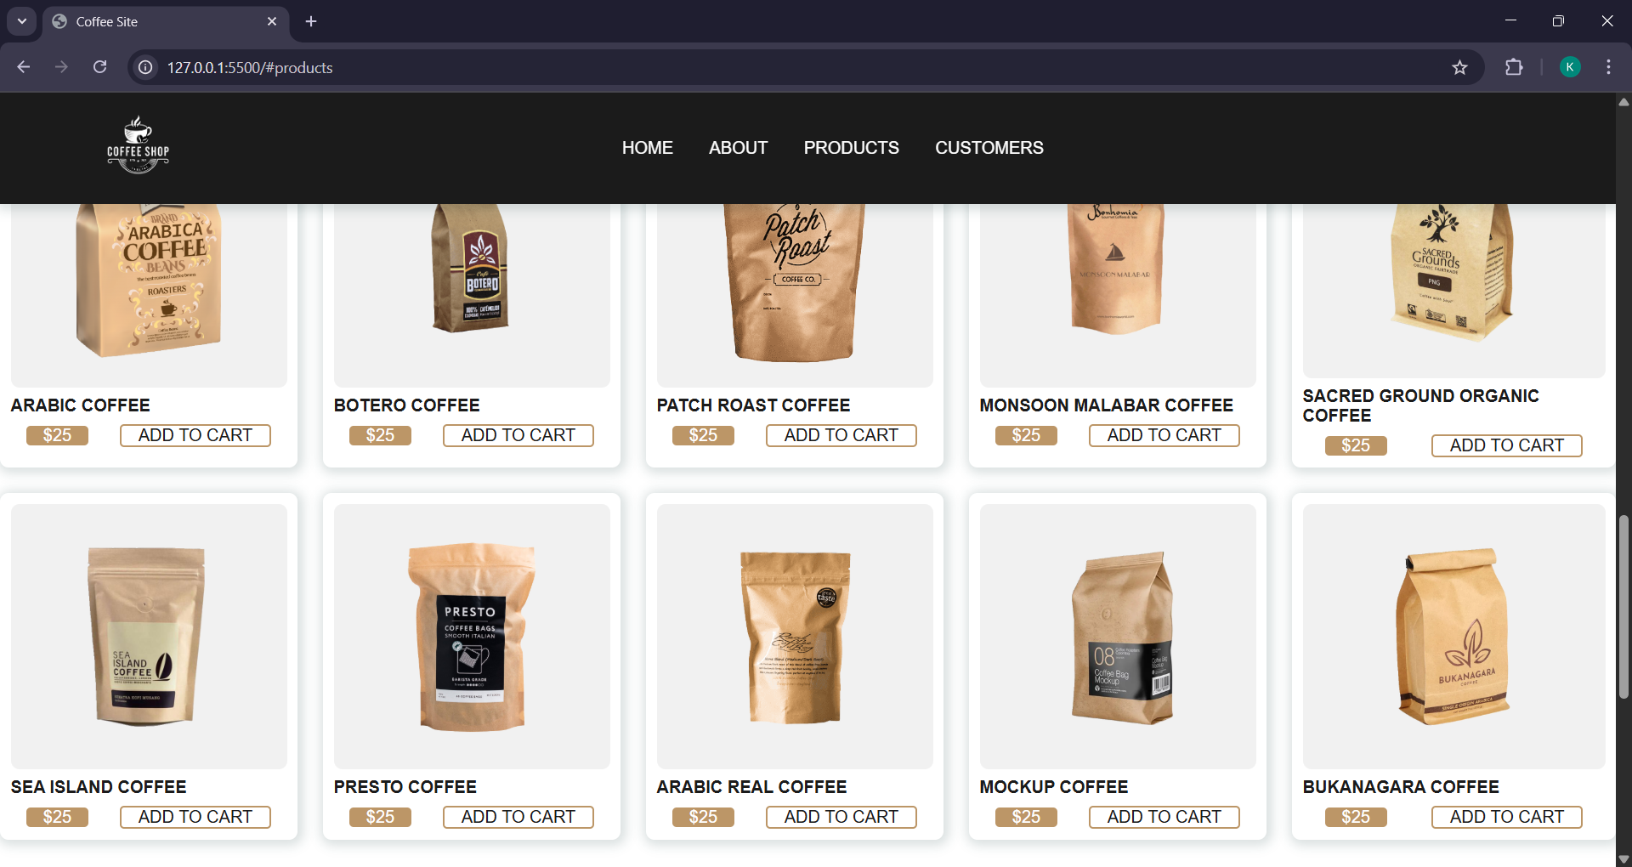
Products

Slide 7
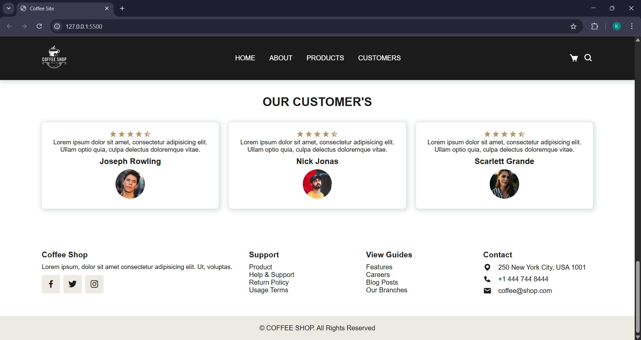
CUSTOMERS SECTION

Slide 8
uses
Our Coffee Website can be used for:
Online shopping: customers can browse and purchase coffee products.
Product reviews: customers can read reviews from other customers.
Information: customers can learn about the coffee shop and its products.
Explanation: "Our website provides a convenient way for customers to shop online and learn about our coffee products."

Slide 9
ADVANTAGES & DISADVANTAGES
Advantages:
- Easy to use and navigate.
- Wide range of coffee products.
- Customer reviews and ratings.
Disadvantages:
- Limited personal interaction. - Dependence on technology.
- Security concerns.

Slide 10
Future scopes
Future developments for our Coffee Website could include: - Integrating online ordering and payment systems using advanced JavaScript.
- Adding more features for customer engagement, such as forums or social media integration.
- Expanding product offerings to include related items, such as coffee-making equipment.
Explanation: "We envision a future where our website continues to evolve and grow, offering new features and opportunities for customers to engage with our coffee shop."

Slide 11
Thank YOU
Student name – MRIGAKSHY KALITA
Batch code –
Wj6f2mb (JULY)

